Slide 1
Control Statements and Loops in Arduino
CSE- 315
Peripherals & Interfacing

Slide 2
Control statements

Slide 3
Control statement:
If
If…. else
If….else if()….else
Switch case
Conditional Operator ?:

Slide 4
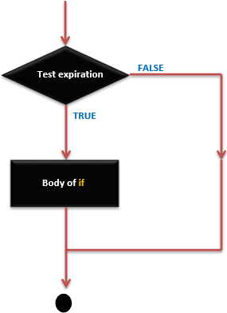
If statement:
if (expression)
statement;
OR,
if (expression) {
Block of statements;
}

Slide 5
If statement: (contd.)
int A = 5 ; /* Global variable definition */
int B = 9 ;
Void setup () {
}
Void loop () { /* check the boolean condition */
if (A > B) /* if condition is true then execute the following statement*/
A++;
/* check the boolean condition */
If ( ( A < B ) && ( B != 0 )) /* if condition is true then execute the following statement*/ {
A += B;
B--;
}
}

Slide 6
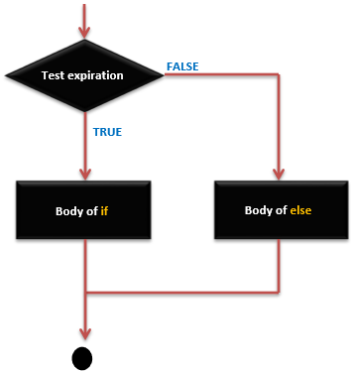
If… else statement:
if (expression) {
Block of statements;
}
else {
Block of statements;
}

Slide 7
If… else statement: (contd.)
int A = 5 ; /* Global variable definition */
int B = 9 ;
Void setup () {
}
Void loop () {
/* check the boolean condition */
if (A > B) /* if condition is true then execute the following statement*/ {
A++;
}else {
B -= A;
}
}

Slide 8
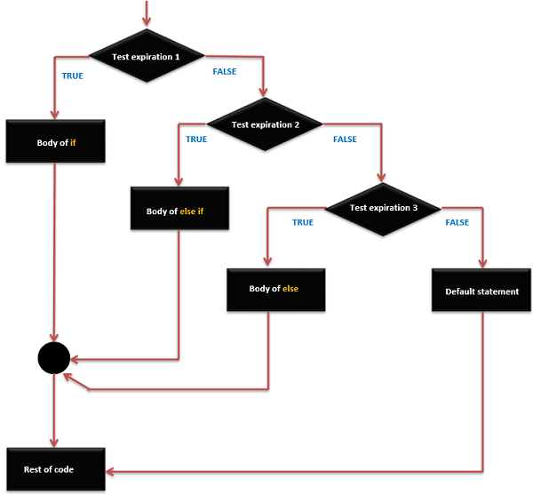
If..else If…. else statement:
if (expression_1) {
Block of statements;
}
else if(expression_2) {
Block of statements;
}
.
.
.
else {
Block of statements;
}

Slide 9
If..else If…. else statement: (contd.)
int A = 5 ; /* Global variable definition */
int B = 9 ;
int c = 15;
Void setup () {
}
Void loop () {
/* check the boolean condition */
if (A > B) /* if condition is true then execute the following statement*/ {
A++;
}
/* check the boolean condition */
else if ((A == B )||( B < c) ) /* if condition is true then
execute the following statement*/ {
C = B* A;
}else
c++;
}

Slide 10
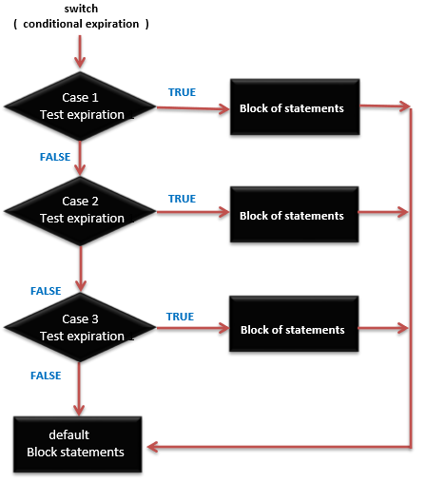
Switch case statement:
switch (variable) {
case label:
// statements
break;
}
case label: {
// statements
break;
}
default: {
// statements
break;
}

Slide 11
Switch case statement: (contd.)
switch (phase) {
case 0: Lo(); break;
case 1: Mid(); break;
case 2: Hi(); break;
default: Message("Invalid state!"); break;
}

Slide 12
Conditional Operator:
expression1 ? expression2 : expression3
max = ( a > b ) ? a : b;
If the condition is true then a otherwise b.

Slide 13
Loops

Slide 14
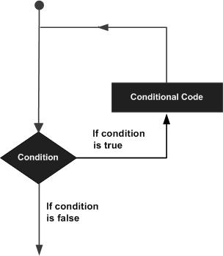
Loops:
While
Do…. While
For
Nested Loop
Infinite Loop

Slide 15
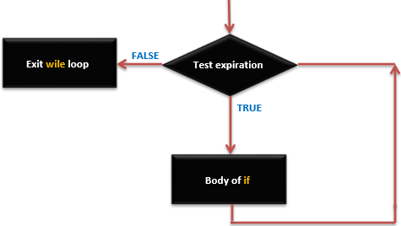
While loop:
while(expression) {
Block of statements;
}

Slide 16
Do… While
do {
Block of statements;
}
while (expression);

Slide 17
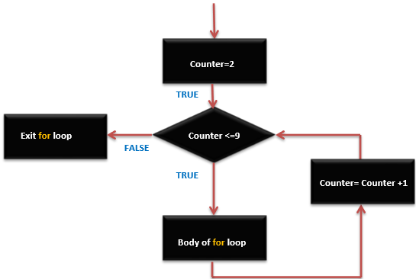
For loop:
for ( initialize; control; increment or decrement) {
// statement block
}

Slide 18
Nested Loop:
for ( initialize ;control; increment or decrement) {
// statement block
for ( initialize ;control; increment or decrement) {
// statement block
}
}

Slide 19
Infinite Loop:
for (;;) {
// statement block
}
while(1) {
// statement block
}
do {
Block of statements;
}
while(1);

Slide 20
analogWrite()

Slide 21
Syntax-
analogWrite(Pin Number, PWM value);

Slide 22
Fading a LED with analogWrite:
Hardware Required:
Arduino or Genuino board
LED
220 ohm resistor
hook-up wires
breadboard

Slide 23
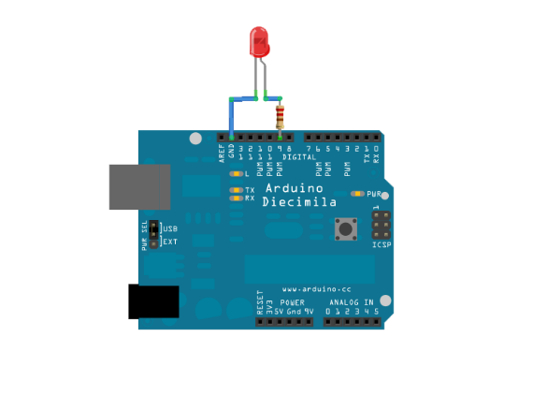
Fading a LED with analogWrite: (Contd.)

Slide 24
Fading a LED with analogWrite: (Contd.)
int ledPin = 9; // LED connected to digital pin 9 void setup() { // nothing happens in setup }

Slide 25
Fading a LED with analogWrite: (Contd.)
void loop() { // fade in from min to max in increments of 5 points: for (int fadeValue = 0 ; fadeValue <= 255; fadeValue += 5) { // sets the value (range from 0 to 255): analogWrite(ledPin, fadeValue); // wait for 30 milliseconds to see the dimming effect delay(30); }

Slide 26
Fading a LED with analogWrite: (Contd.)
// fade out from max to min in increments of 5 points: for (int fadeValue = 255 ; fadeValue >= 0; fadeValue -= 5) { // sets the value (range from 0 to 255): analogWrite(ledPin, fadeValue); // wait for 30 milliseconds to see the dimming effect delay(30); } }

Slide 27
Fading a LED with analogWrite: (Contd.) [Loop code at once.]
void loop() { // fade in from min to max in increments of 5 points: for (int fadeValue = 0 ; fadeValue <= 255; fadeValue += 5) { // sets the value (range from 0 to 255): analogWrite(ledPin, fadeValue); // wait for 30 milliseconds to see the dimming effect delay(30); } // fade out from max to min in increments of 5 points: for (int fadeValue = 255 ; fadeValue >= 0; fadeValue -= 5) { // sets the value (range from 0 to 255): analogWrite(ledPin, fadeValue); // wait for 30 milliseconds to see the dimming effect delay(30); } }

Slide 28
Thank You

